Slide 1

Production Peaks & Declines in NFL Players
Drew Kearny

Slide 2

Introduction & Overview
Forecasting player performance declines is crucial for scouts and executives in the NFL.
Variability By Position:
Running Backs might be prone to decline in mid-20s due to physical demands.
Quarterbacks remain effective into their 30s. EX : Tom Brady maintained peak performance into his 40s.
Study Focus:
Identify on field player production peak and decline trends across Age, Years Played, and Cumulative Snaps.
Focus on Key offensive positions: QB, RB, Wide Receiver (WR), Tight End (TE).
“Production” is measure by the variable PPR Fantasy Points Per Game.

Slide 3
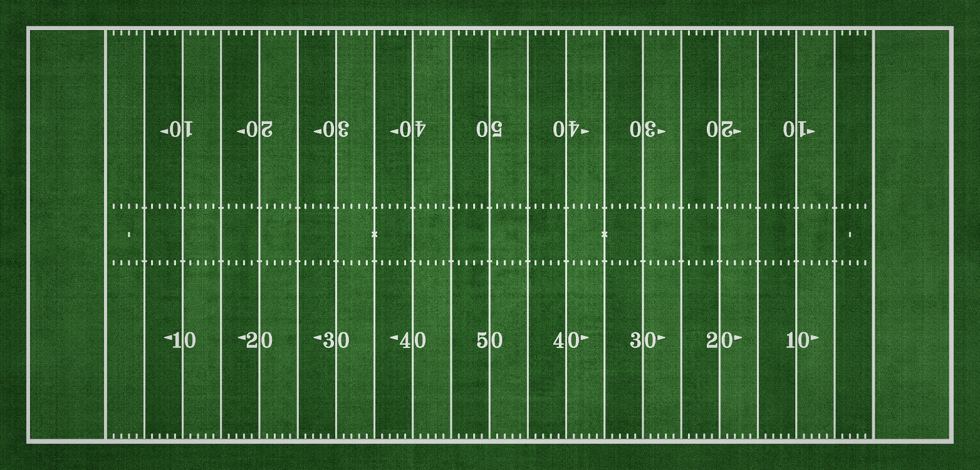
Importance of The Study
Competitive Edges To Teams For:
Contracts, Draft strategies, and Roster management
Optimizing player usage
Maximizing output during prime years.
Player Agents Can Use For:
Contract timing & length
Fantasy Football Industry Can Use For:
Choosing Players
Understanding player dynamics

Slide 4
Research Objectives
Objectives:
Determine the age, years played, and cumulative snap counts when player production begins to decline
Is there an "age cliff" ? Is the "years played cliff" more informative?
Notes:
Cumulative Snap Counts:
Investigate snap counts at which production peaks and declines.
Offers perspective for players missing games due to injury.

Slide 5
Data
Data Details:
NFL data from nflverse ranging from 2000 to 2023.
3,099 unique NFL players at QB, TE, WR, and RB positions.
Variables Included:
Player statistics and Snap Counts
Demographics
Additional metrics created like Rush yards per carry and AVG PPR fantasy points per game

Slide 6

Exploratory Data Analysis: Data Preparation
2,436 row entries removed due to
Missing birth dates
Fewer than two games.
Zero fantasy points per game.
Final Dataset:
2,515 unique players.
9,156 total rows of player-season data.
Transformed Response Variable:
Applied log transformation to ‘PPR Fantasy Points” for RBs, WRs, TEs
Untransformed for QBs
Notes:
Analysis Tools:
Pearson correlation coefficient matrices.
Principal Component Analysis (PCA).
Findings:
Fantasy points PPR per game had:
Strongest associations with other production metrics.
Highest contribution to the first principal component (>80% variance explained by first component).
Decision:
Selected PPR fantasy points per game as the response variable for analysis.

Slide 7

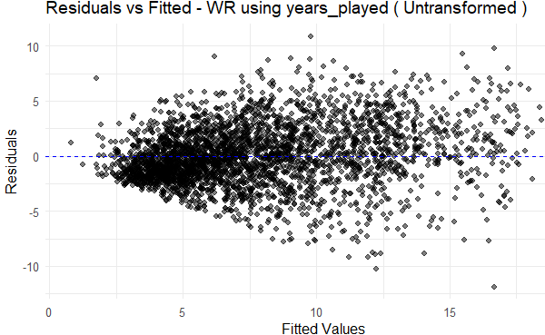
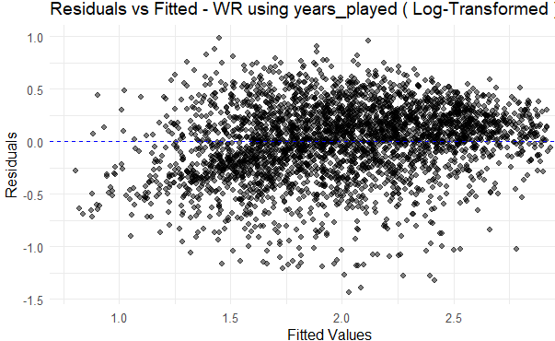
Exploratory Data Analysis
Residuals vs Fitted Plot before log transformation for the Linear Mixed-Effects years played WR Model
Residuals vs Fitted Plot after log transformation for the Linear Mixed-Effects years played WR Model

Slide 8
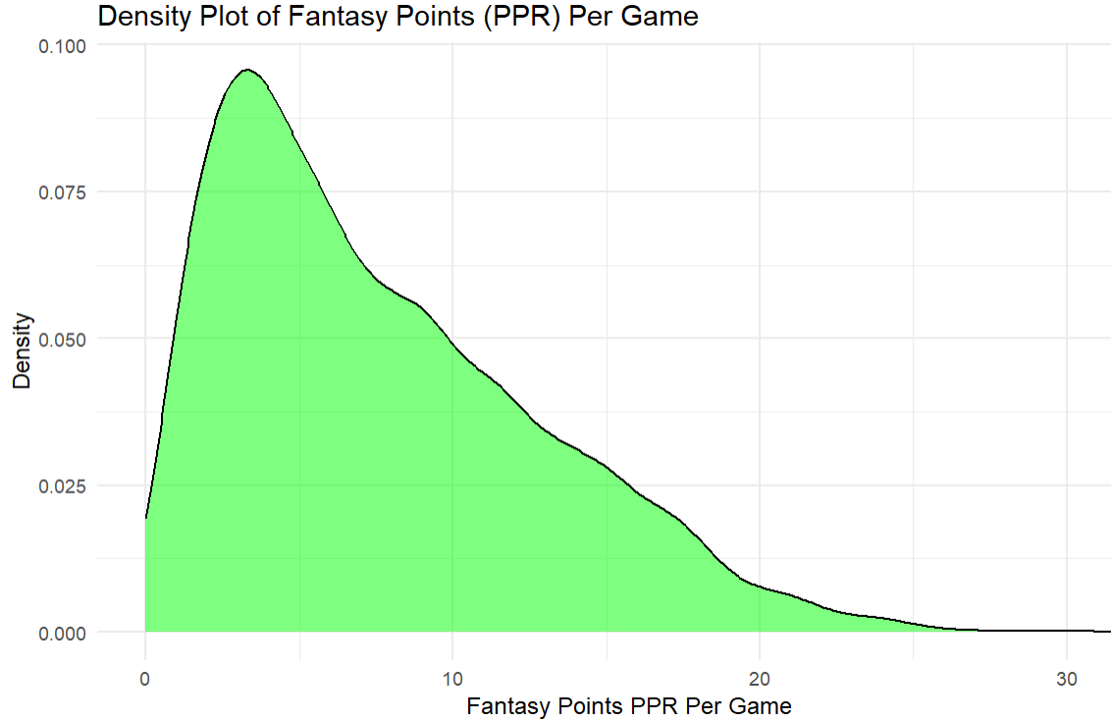
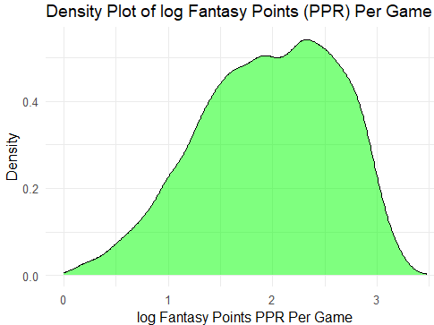
Exploratory Data Analysis

Slide 9
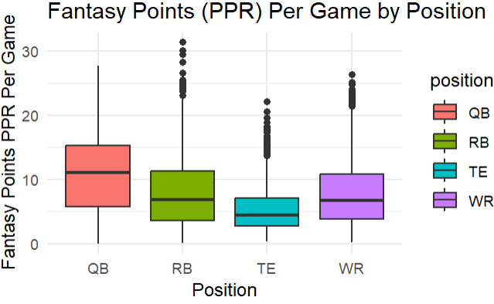
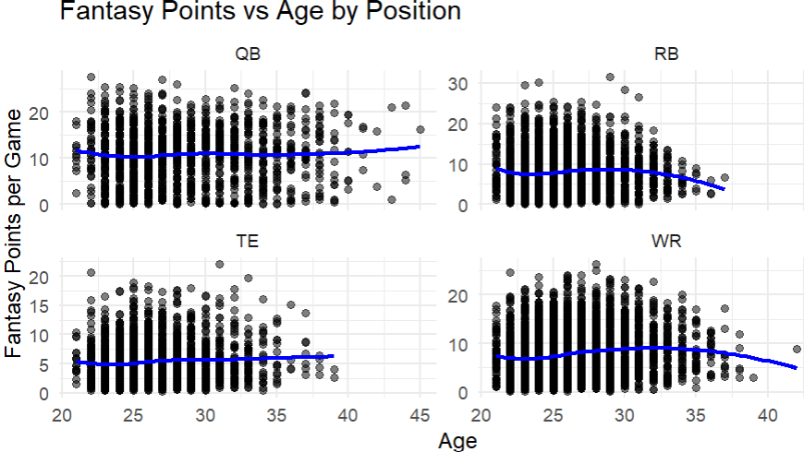
Trend Discoveries
Box Plots of Fantasy Points Per Game By Position
Fantasy Points vs Age Relationship by Position
Separate models for each position group will capture unique characteristics.
Notes:
Position Differences:
Notable variations in PPR fantasy points trajectories.
Data Visualization:
Box plots show significant differences among positions.
Means, medians, ranges vary.
Age vs. fantasy points relationships differ by position.
Implication:
Highlights importance of accounting for positional differences.

Slide 10
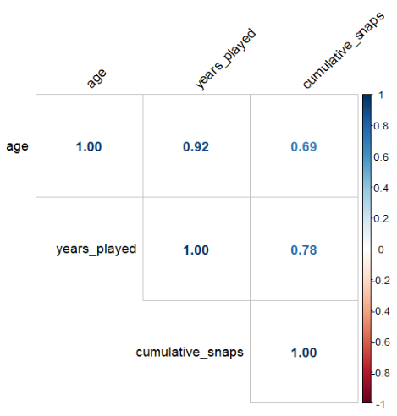
Relationships Between Predictors
Takeaway:
Separate models for each predictor rather than all in one Model
Predictor Variable Pearson Correlation Matrix

Slide 11
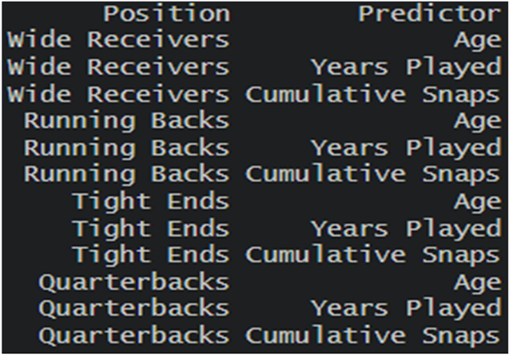
Statistical Methods
Model Types Tested:
Simple linear models.
Quadratic models.
Mixed-effects models.
Selected Quadratic Mixed-Effects Models:
Created 12 Separate models:
3 predictors (age, years played, cumulative snaps).
4 positions (QB, RB, WR, TE).
Fixed effects for Age, Years Played, and Snaps
Random effects for variability among individual players.
Quadratic terms for non-linear trajectories.
12 Separate Models

Slide 12

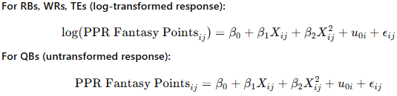
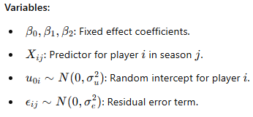
Model Specification
Models Developed:
12 quadratic mixed-effects models:
3 predictors x 4 positions.
Predictors:
Age
Years played
Cumulative snaps (scaled by dividing by 1,000 for interpretability).

Slide 13
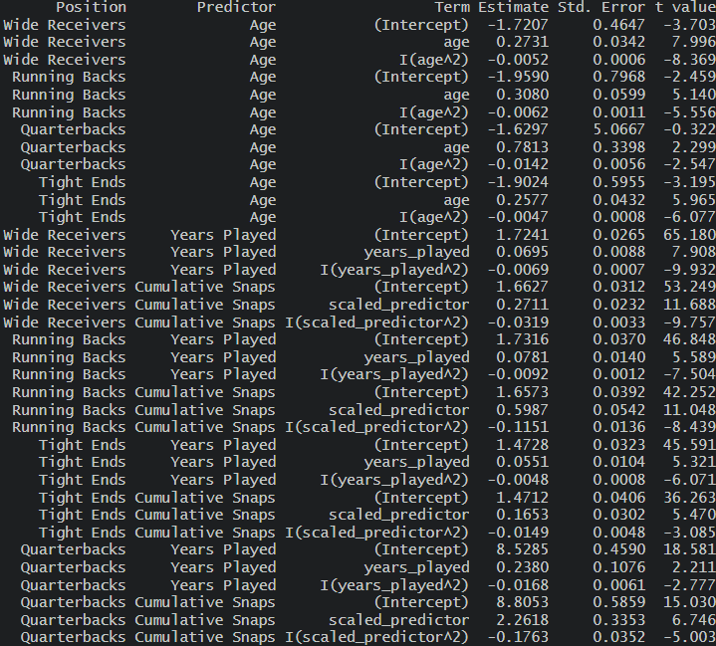
Analysis Results
Table displaying the Intercept and Standard Errors for the Predictors in Each Model
Results:
Positive Age coefficient means Performance increases with age.
Negative Age Squared coefficient means production slows and reverses (inverted U-shape).

Slide 14
Interpretation
Table displaying the Intercept and Standard Errors for the Predictors in Each Model
Model Conclusions:
All coefficients were significant (p < 0.001).
Model captures non-linear productivity trajectory.

Slide 15
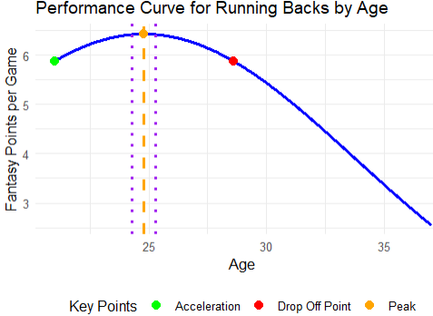
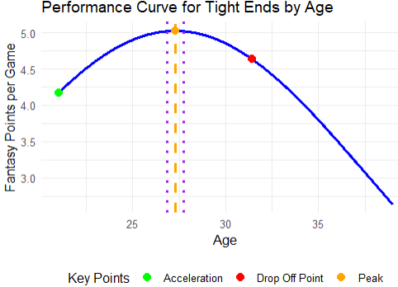
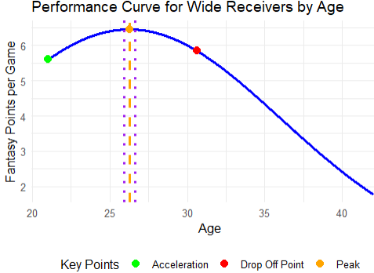
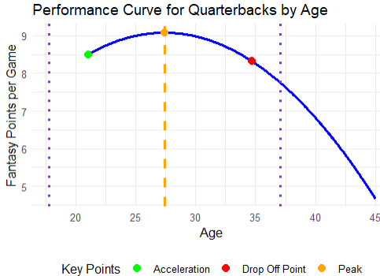
Results & Discussion Age Models
Back-transformed from log
Peak Point is the vertex
Performed bootstrap resampling to estimate standard errors of peak points.
Drop-off is where the absolute change in fantasy points exceeds the average.

Slide 16
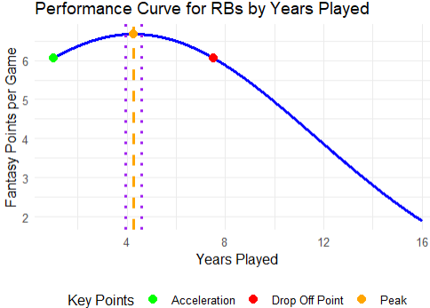
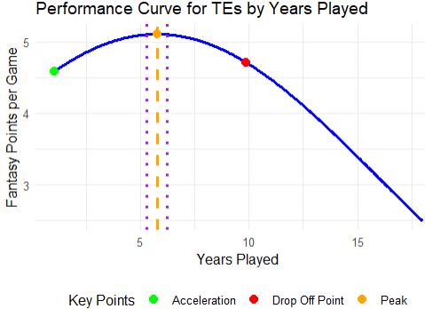
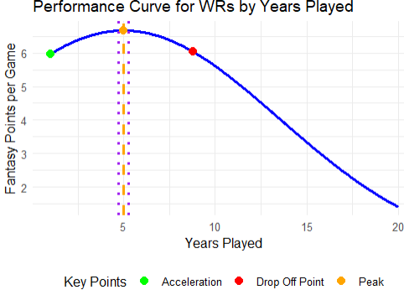
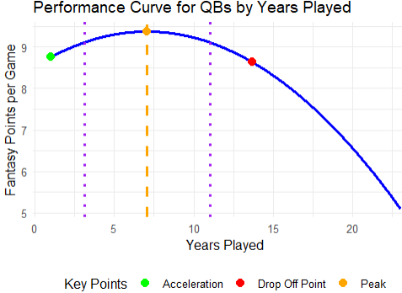
Results & Discussion Years Played Models

Slide 17
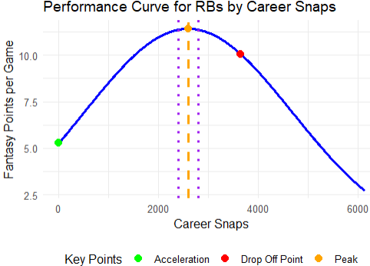
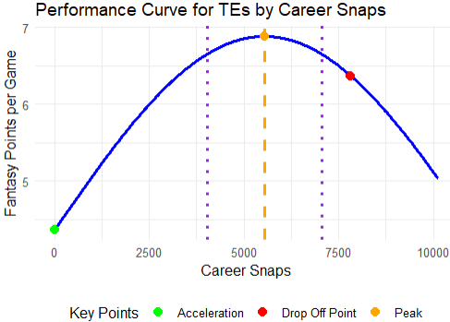
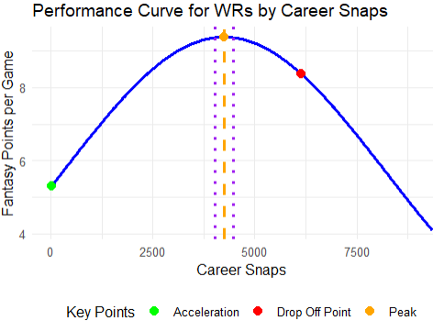
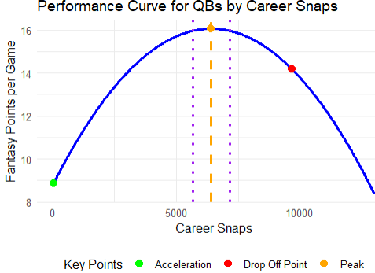
Results & Discussion Cumulative Snaps Models

Slide 18
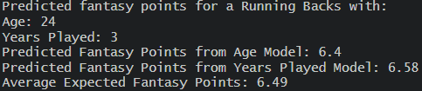
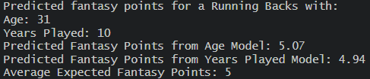
Applications
Predicting the Average Fantasy Points (Production) based on any Input of Predictors

Slide 19
Applications & Conclusions
Key Findings:
RBs peak earlier and decline sooner
QBs enjoy longer peak periods.
Age, years played, and cumulative snaps are all significant predictors of performance decline.
Years played has the highest confidence
Production typically drops quickly for Non-QBs Aged 30+

Slide 20
Applications & Conclusions
So Now What?
NFL Teams should:
Limit and monitor workloads for faster declining positions like RB.
Structure contracts aligning with expected performance.
Avoid long-term commitments to players likely to decline.
Give longer term contracts to QBs
Sign RBs for Shorter Contracts
Players and Agents should:
Capitalize on high value contracts when players are at their peak
Ensure financial stability before performance declines.
Limit over usage to preserve performance.
Fantasy Football Players Should:
Target players around their peaks.
Avoid players getting closer to their “age cliff”

Slide 21
References
Barrett, S. (2018, March 31). Metrics that matter: The aging curves by position. Pro Football Focus. Link
Hornsby, W. G., & Lewis, M. (2013). Evaluating the effects of aging for professional football players in combine events using performance-aging curves. ResearchGate. Link
Priem, R. L., & Walker, K. (2023). Catching a falling star: Mobility of declining star performers. Journal of Business Research, 161, 113–122. Link
Hilton, R., & Alexiou, C. (2022). No sport for old players: A longitudinal study of aging effects on performance. Sport Management Review, 25(2), 271-285. Link
Baldwin, P., Fisher, B., & Nguyen, L. (2023). nflreadr: Fast, friendly, and free football data (R package version 1.3.2). Retrieved from https://github.com/nflverse/nflreadr
Wickham, H., François, R., Henry, L., & Müller, K. (2023). dplyr: A Grammar of Data Manipulation (R package version 1.1.1). Retrieved from https://CRAN.R-project.org/package=dplyr
Wickham, H., Averick, M., Bryan, J., Chang, W., D’Agostino McGowan, L., François, R., Grolemund, G., Hayes, A., Henry, L., Hester, J., Kuhn, M., Pedersen, T. L., Miller, E., Bache, S. M., Müller, K., Ooms, J., Robinson, D., Seidel, D. P., Spinu, V., … Yutani, H. (2019). Welcome to the tidyverse. Journal of Open Source Software, 4(43), 1686. https://doi.org/10.21105/joss.01686

Slide 22
Questions?

